Slide 1

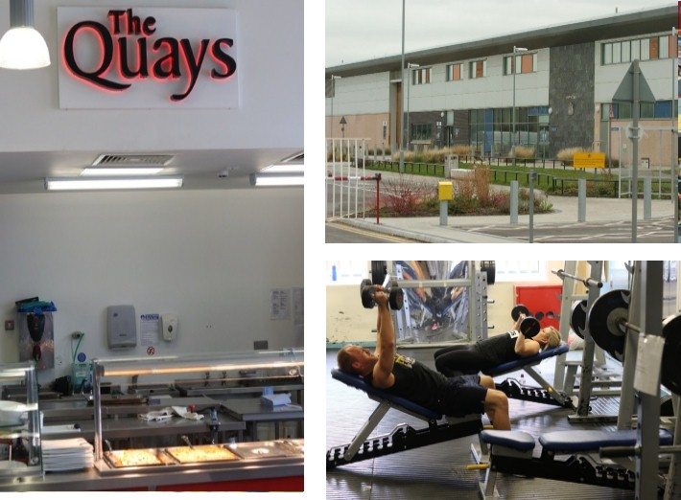

Prison Officer Recruitment
HMP Pentonville and
HMP/YOI Wormwood Scrubs:
Candidate Pack

Slide 2
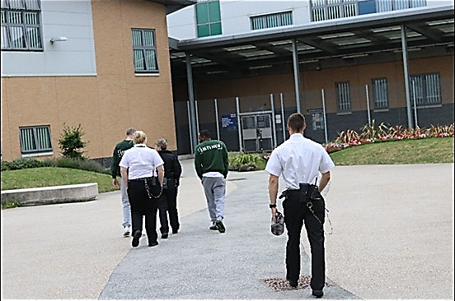
Prison Officer Recruitment
Welcome
The Recruitment Process
Your Recruitment Assessment Day
HMPPS Equality Statement

Slide 3
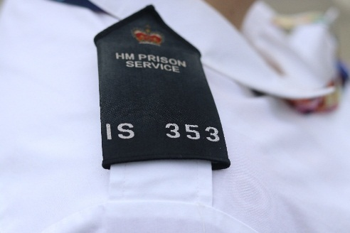
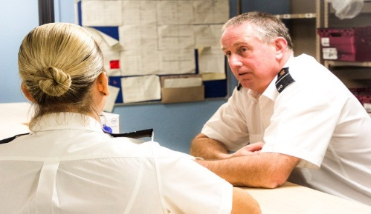
Prison Officer Recruitment
Thank you for your interest in applying to become a Prison Officer with Her Majesty’s Prison and Probation Service (HMPPS). We’re delighted that you’re interested in our prisons.
  By applying for this campaign, you could be working at either HMP Pentonville or HMP/YOI Wormwood Scrubs. Candidates will be allocated to either one of these prions based on business need and not by candidate preference. Candidates applying to this campaign should be able to travel to and work at either prison.
This pack contains everything you need to know about our recruitment process. From application, through to booking on your training, we hope you find it useful.
If, after reading this pack, you have any questions, you can get in touch with us on 0845 241 5358.
We wish you the best of luck with your application and look forward to you joining HM Prison and Probation Service if you are successful.

Slide 4
Prison Officer Recruitment
Being a Prison Officer is a challenging job, where you can make a real difference to someone’s life. That’s why we’re piloting a more streamlined approach to our recruitment process.
Our process is made up of four main parts. You’ll need to be successful at each stage to move on to the next.
Online Application Form
Online Test
Recruitment Assessment Day
Pre-Employment Checks and Vetting
You must complete your application form within seven days.
If you move onto the online test, you’ll be asked several questions with multiple choice answers, testing four key skills. It tests your decision making, problem-solving, interpersonal and organisational skills.
If you pass the online test, you’ll be invited to one of our Recruitment Assessment Days at the Holloway RAD Centre. On the day, you’ll take part in three job related role-play simulations, a fitness test and a maths and English test (activity dependent on passing each stage independently).
Once you’ve passed the Recruitment Assessment Day, we will undertake a series of checks to make sure you’re eligible to work in the UK and can verify your address and ID. This is a really important part of recruitment process, so please make sure you have the documentation you need from the outset. This will be:
You’ll also start your vetting checks at your assessment day - so it’s absolutely vital that you bring all the right documentation with you.
Identity documents such as a birth certificate, driving license or passport.
Utility bills or bank statements. These need to be in your name, and not more than three months old.
You’ll also need to provide five year’s worth of employment references (or justification for a gap) which we will verify with HMRC.

Slide 5
Prison Officer Recruitment
The Recruitment Assessment Day is a chance to explore your values and reactions in a prison officer role and will be made up of:
  Three ten minute job-related role-play simulations
  A fitness test and medical
  A maths and English test
  Pre-employment checks
  Confirmation of allocated establishment
You will need to pass each section independently to move onto the next stage.
You’ll start the day with a briefing session, where you can find out more about the day itself, where you’ll be and what time you’ll be completing activities. This doesn’t make up part of your assessment, but is a chance for you to ask any questions you might have.
The next few pages outline what you can expect at your Recruitment Assessment Day in more detail, including any domestics. We’ve also provided a checklist at the end of this candidate pack to help you remember what you need to bring.
Finally, we know that things don’t always go according to plan. If there’s anything that you think we may need to know that could affect your performance on the day, it’s important you tell staff on the day or get in touch on 0845 241 5358.
Don’t forget, if you applied through the Guaranteed Interview Scheme, we will have spoken to you about potential reasonable adjustments but it’s important you tell us if anything changes.

Slide 6

Prison Officer Recruitment
We’ve included some information to help you succeed at your Recruitment Assessment Day.
The Fitness Test and Medical
Although you’ll need to take part in a basic fitness test and medical exam - don’t worry, there’s plenty of information available at:
http://www.PrisonandProbationJobs.go.uk
You will be provided with all the instructions and information that you need on the day by a trained fitness assessor and nurse.
Remember to bring exercise appropriate clothing and trainers for the fitness test, in addition to appropriate clothing and comfortable footwear for the day.
You’ll have the opportunity to shower afterwards, so if you’d like to bring toiletries and a towel along with your change of clothes you can.

Slide 7
Prison Officer Recruitment
Understanding the competencies tested
You need to demonstrate seven competencies in order to become a prison officer. These competencies will be assessed during three ten minute role play simulations which will be video recorded. The role play simulations will be based on situations that you could face as a prison officer, however you do not require prior knowledge of the role. You will have ten minutes to deal with each simulation. Recording the assessments ensures that they are conducted objectively and fairly, allowing assessors to check simulations where necessary.
Please familiarise yourself with the seven assessed competencies by watching the videos of prison officers discussing what each competency means to them.
Treat the role-plays exactly as you would do in real life situations. Be yourself; we want to measure your skills in the most natural way possible.
On the following pages, we’ve provided some information on what our values are to help you think about times when you’ve displayed these throughout your work experience so far. In particular, we will want to know why you chose to do something and why it mattered to you.

Slide 8
Prison Officer Recruitment
Understanding the competencies tested
Acting with Integrity
Acting with integrity is a measure of what you believe in, what you stand for, and knowing what’s right and wrong. We test this so that we can assess how much you believe in and apply the prison rules. The prison rules are put in place to protect both staff and prisoners and it is the role of the prison officer to make sure these are being adhered to by colleagues and prisoners.
Exploring and Clarifying
Asking questions is something that prison officers must do all the time - whether that is when speaking to someone in distress to encourage them to open up or to obtain information that may impact on the security of the prison. Exploring information or clarifying understanding can encourage further information to be exchanged, as well as demonstrating to individuals that you are genuinely engaged in the conversation and interested in what is being said.
Assertion
The most important thing about being assertive is understanding that assertion does not equal aggression. It is about having confidence in your interactions and showing respect in the way that you behave. Whilst it is essential that you are not aggressive, it is also important not to appear submissive as people could see you as someone to be manipulated or intimidated.
Non-Verbal Listening Skills
Think back to conversations that you’ve had when you knew people were listening to you. What did they do to express this? These aren’t the things people say; it’s what they do to display interest and engagement non-verbally. However, when observing others, remember that these non-verbal signals can vary depending on people’s background's so it is important not to assume that someone is not engaged simply because their communication style appears different to your own.

Slide 9
Prison Officer Recruitment
Understanding the competencies tested
Respecting Others
It is enormously important to show respect towards each other – prison is a community that is extremely diverse. Prison officers need to behave in a way that encourages respect to be shown to all and to challenge inappropriate or discriminatory actions. HMPPS has an equality statement which all staff, prisoners and visitors are expected to adhere to.
Showing Understanding
Showing understanding is fairly self-explanatory. It’s really about putting yourself in someone else’s shoes, thinking about how you would feel in the same situation and how to respond in a caring way. Think about how you would be there for a friend or a family member if they had a problem or were upset – what types of things would you do? What we’re looking for is people that can show empathy and sympathy in a genuine way.
Suspending Judgement
It is important to be aware of the impact of what you say can have on a situation, especially for those in potentially volatile circumstances. You need to be aware of the possible effects of what you say, making sure that it isn’t unhelpful or unsupportive. It is extremely important that prison officers don’t make assumptions or unjustified judgements that might undermine the interaction or cause the other person to feel judged.

Slide 10
Prison Officer Recruitment
Directions to Holloway RAD Centre
Address: Parkhurst Road, London, N7 0NU
The Assessment Centre is situated near the Visitors Centre on the right hand side of the main entrance
to HMP Holloway. Before you reach the barrier, there is a sign for the London Assessment Centre.
Turn right down a pathway which leads to a door labelled ‘Candidate Entrance’. Press the white buzzer below the key code pad. A member of staff will be on hand.
Bus | Any bus can be taken from the bus stop immediately outside Caledonian Road underground station and will drop passengers directly outside the RAD Centre (former HMP Holloway).
Train | The nearest underground station to HMP Holloway is Caledonian Road on the Piccadilly line, just one stop away from Kings Cross. Any bus can be taken from the bus stop immediately outside Caledonian Road underground station and will drop passengers directly outside the RAD Centre (former HMP Holloway). Alternatively, Holloway Road underground station (also on the Piccadilly line) is two stops from Kings Cross and 20 minutes walk away.
Car | From the North: Visitors should follow the A1 signposted ‘City’ (from the M1 to junction 2 then follow the A1/A41 again signposted ‘City’). Holloway Road is in fact the A1. After passing under the Archway bridge, still on the A1/Holloway Road, HMP Holloway is about a mile away and visitors should look out for the Odeon cinema on the right by a traffic light controlled junction. Go straight over these lights and straight over the next set, until another set of lights where there is a right hand filter lane. Turn right here into Camden Road and proceed to the traffic lights at the top of the hill, turn right at these lights and the prison gate is directly opposite. From the South: Visitors should follow signposts from Marylebone Road/Euston Road for Camden and The North. On Camden High Street there is a public house named ‘The World’s End’ where the High Street divides. Visitors should bear right and follow the signposts for Holloway and The North. HMP Holloway is approximately 1.5 miles from Camden, follow Camden Road up the hill and there is a set of traffic lights just over the brow. There is a garage at the junction of Parkhurst Road/Camden Road and the ‘Holloway Castle’ public house is on the right hand side. The prison main gate is on the left opposite the garage.
Parking | HMP Holloway does not have car parking facilities.

Slide 11
Prison Officer Recruitment
HMPPS Equality Statement
HMPPS is committed to fairness for all. We treat our staff properly and ensure equality of opportunity. We deliver our services fairly and respond to individual needs.
We insist on respectful and decent behaviour from staff, offenders and others with whom we work.
We recognise that discrimination, harassment and bullying can nevertheless occur and we take prompt and appropriate action whenever we discover them.
Reasonable adjustments for candidates with requirements specific to their needs
The purpose of reasonable adjustments:
Reasonable adjustments are arrangements that are approved before the assessment to enable candidates, who might not otherwise be able to do so, to demonstrate their competence.
Reasonable adjustments may be needed for candidates having a physical or mental impairment which has substantial or long-term adverse effects on their ability to carry out normal day-to-day activities (as defined under the Equality Act 2010); and for candidates who have a temporary disability or indisposition at the time of the assessment.
Candidates wishing to apply for reasonable adjustments for this assessment who have not done so already should contact PADE@hmps.gsi.gov.uk. All applications will be dealt with individually, professionally and in confidence.
Quality assurance
The assessment process will be subject to an independent quality assurance review.

Slide 12
Prison Officer Recruitment
HMP Belmarsh
Prison Officer Recruitment
Application Stage
Complete application within seven days of starting. | □
Online Tests
Read overview guidance for the online test before completing the test. | □
Recruitment Assessment Day
Identification documents – a full list will be detailed once you pass the online test. | □
Completed pre-assessment health questionnaire. | □
Lunch and snacks – avoid caffeinated drinks as these can affect your blood pressure. | □
Glasses and contact lens (with solution). | □
Exercise appropriate clothes for your fitness test. | □
Toiletries and a towel if you wish to shower. | □
Comfortable shoes. | □
Pre-Employment Checks and Vetting
Uploaded documents to health questionnaire (normally this will happen at your Recruitment Assessment Day. | □
I’ve provided five year’s employment references (or gaps) and dates are correct. | □
I've responded to my offer of employment. | □

