Slide 1
Role : Support Services Administration – Visits Booking
Grade : Band 2

Slide 2
HM Prison & Probation Service (HMPPS)
What we do
Her Majesty’s Prison and Probation Service (HMPPS) is to here to prevent victims by changing lives. We work with our partners to carry out the sentences given by the courts, either in custody or the community.
We reduce reoffending by rehabilitating the people in our care through education and employment.
The agency is made up of Her Majesty’s Prison Service, the Probation Service and a headquarters focussed on creating tools and learning.
Responsibilities
Within England and Wales, we are responsible for:
running prison and probation services
rehabilitation services for people in our care leaving prison
making sure support is available to stop people reoffending
contract managing private sector prisons and services such as, the prisoner escort service & electronic tagging
Through HM Prison Service: we manage public sector prisons and the contract for private prisons in England and Wales.

Slide 3
HMP Full Sutton
About us
HM Prison Full Sutton is a men's prison in the village of Full Sutton, near Pocklington, 10 miles east of York. It is operated by Her Majesty's Prison Service and holds up to 596 prisoners and has a staff of almost 650.
HMP Full Sutton opened in 1987 and is a High Security Dispersal establishment which is part of the Long Term and High Security Estate Directorate, with a complex prisoner population. The establishment accommodates both vulnerable prisoners as well as those convicted of more mainstream offences. Residential accommodation is split over six wings, a Segregation Unit, and a Healthcare Centre (24hr cover). The prison also has a Closed Supervision Centre (CSC) and a Separation Centre.
Why join HMP Full Sutton
Working in the Prison Service offers a unique challenge – that’s why we are committed to ensuring that anyone joining the service is equipped with the right skills, and the right level of support from their 1st day in the job and throughout their career with us.
Staff training
We are committed to ensuring that all Prison Service employees have access to additional training & learning, in addition to our formal apprenticeships, to aid in professional development. There are a wide range of courses available to all employees, both operational and non-operational – with a mixture of face-to-face and virtual learning on offer.
Mentoring
As a new member of staff, you will be supported by a New Colleague Mentor who will support you by helping to ensure you feel welcomed, supported, capable and confident in your role as you us, and through your early journey with us, setting you in good stead for your career in the prison service. They will support you with your onboarding experience and ease your transition into the prison environment.
Treating you fairly - values & inclusivity
Running through the core of the Prison Service & HMPPS as a whole is a commitment to fairness, equality and inclusivity in everything that we do. As an organisation, we are absolutely committed to rooting out discrimination and ensuring that the Prison Service is an inclusive place to work for all.

Slide 4
HMP Full Sutton
Occupational Health
As Prison Service employees, staff have full access to our staff OH service. An OH Workplace Wellbeing Platform hosted by HMPPS OH provider (Optima Health) was launched at the end of 2021 providing both workplace health and general health advice. The platform also signposts to EAP and offers guidance from a range of issues that can affect everybody from menopause, to financial management to coping with the Ukraine crisis and Covid-19 recovery.
Pension benefits
Prison Service employees are members of the Civil Service Pension ’Alpha’ Scheme, which is a Defined Benefit (this means staff will be provided with annual estimates of the benefits they could receive on reaching pension age) scheme which provides a secure pension for life with no investment uncertainties (as there are with other occupational schemes). Public sector schemes are still among the best occupational pension schemes available. The contribution you make into the scheme is one of the lowest of the public sector schemes (currently around 5.4% of your pay), and we as the employer make a significant contribution into the pension (currently 27% of your pay).
Sick pay
We believe in creating a workplace environment that supports our wellbeing and empowers us to look after our health. HMPPS recognises that employees may be absent from work due to ill-health from time to time during the course of their employment. During such absences, it is essential to provide employees with all possible help and support to encourage a swift recovery and return to work, so reducing any adverse effect on services.
Sick pay entitlements vary across different business groups and they depend on whether staff are on pre-modernised or modernised Terms and Conditions. For example, staff new to MoJ, on modernised Terms and Conditions are as follows:
Sick pay entitlement is subject an employee’s length of service up to a maximum of 10 months sick pay in a 4-year rolling period.
Annual leave
Those new to the Prison Service are entitled to 25 days’ annual holiday (rising to 30 days after 10 years’ service) and paid time off for public holidays and 1 extra privilege day. Due to the 24/7 nature of operational roles, staff in these posts are expected to work on some public and bank holidays. Any that they do work, however, will be added to their annual leave entitlement.

Slide 5
HMPPS Values
Our values (outlined below) are important to us – they reflect the reasons we do what we do and inspire us to do our best for one another and for those we manage. They remind us that the work we do really matters They unite us in our common purpose.
Purpose Justice matters. We are proud to make a difference for the public we serve.
Humanity We treat others as we would like to be treated. We value everyone, supporting and encouraging them to be the best they can be.
Openness We innovate, share, and learn. We are courageous and curious, relentlessly pursuing ideas to improve the services we deliver.
Together We listen, collaborate and contribute, acting together for our common purpose.
Our vision is for HMPPS to work together to protect the public and help people lead law-abiding and positive lives. This vision is supported by four principles:
enabling people to be their best
an open learning culture
transforming through partnerships, and
modernising our estates and technology

Slide 6
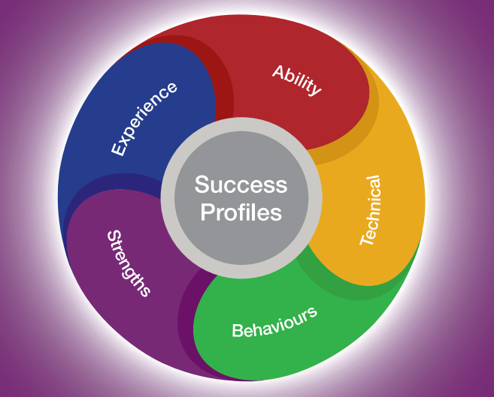
Success Profiles
We will be using the Civil Service Success Profiles to attract and retain people of talent and experience from a range of sectors and walks of life
The elements that will be used for this role are:
Behaviours – the actions and activities that people do which result in effective performance in a job.
Strengths - the things we do regularly, do well and that motivate us.
Full details of Success Profiles can be found at: Success Profiles - GOV.UK (www.gov.uk)

