Slide 1






Candidate Information Pack
Job Role: Customer Service Advisor
Grade: Grade Administrative Assistant / Band E
Vacancy Reference: 29803
Closing Date: 22/10/2019

Slide 2
Contents
3 Message from Nick Goodwin, Chief Executive and Public Guardian
4 OPG’s role and responsibilities – who we are and what we do
5 OPG’s values
6 OPG’s locations
7 What’s it like to work for OPG?
8 Career progression potential at OPG
9 Introduction to the role of Customer Service Advisor
10-11 Job description, responsibilities and duties. Essential and desirable criteria.
12-13 Salary and benefits, terms and conditions, annual leave and pension
14 Flexible arranges to enhance work/life balance
15 Flexible benefits
16 Our recruitment process and Success Profiles
17 Recruitment timeline
18 Frequently asked questions
19 Contact us

Slide 3
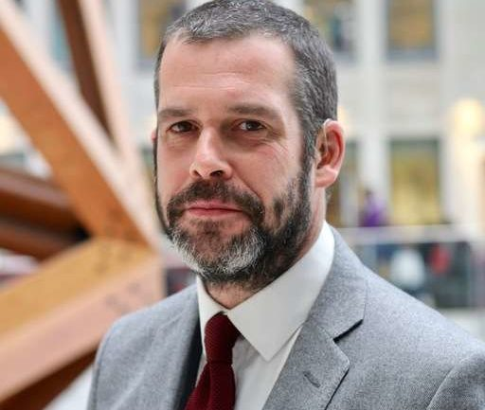
Message from the CEO
Thank you for your interest in a career at the Office of the Public Guardian (OPG).
OPG offers a great opportunity to contribute to some vital work which will only increase in its significance as we react to the needs of an ageing population. Simply put, our purpose is to protect adults at risk and support them to make their own decisions – you can come into
the office every day knowing you’re making a difference to people’s lives.
We work hard to make OPG a brilliant place to work, putting our values at the heart of everything we do.
We’re passionate about inclusion and creating a sense of belonging
for all our people. With a wide range of staff networks, there’s rarely
a week that passes without an opportunity to celebrate and embrace
our successes and our diversity.
We also place a value on learning, training and flexible working.
“We work hard to make OPG a brilliant
“place to work, putting our values at
“the heart of everything we do”
“The following pages of this pack
“will tell you more about OPG and
“the nature of the role you’re
“applying for.
“If you believe you have the
“experience and qualities we’re
“seeking, we look forward to
“hearing from you.
“Nick Goodwin
“Public Guardian

Slide 4
Public Guardian role and responsibilities
The Office of the Public Guardian (OPG) is an executive agency of
the Ministry of Justice (MoJ).
Our Chief Executive, Nick Goodwin, is responsible to the Lord Chancellor and Secretary of State for Justice for the effective
operation of the agency.
OPG supports the Public Guardian in carrying out the legal functions of the Mental Capacity Act 2005. The Act protects people in
England and Wales who do not have the mental capacity to make certain decisions for themselves in relation to their health and welfare or property and financial affairs. OPG has a role in supporting and providing safeguarding to the adults at risk who we come into contact with.
OPG is responsible for
Registering lasting and enduring powers of attorney (LPAs and
EPAs) so that people can choose who they want to make certain decisions on their behalf, if they lose capacity to make those
decisions for themselves.
Maintaining the public register of attorneys and deputies
appointed by the Court of Protection.
Supervising deputies appointed by the Court of Protection,
making sure they carry out their responsibilities in the best
interests of their clients and in line with the requirements of the
Mental Capacity Act, and carrying out investigations and taking
action where there are concerns about an attorney or deputy.
OPG’s Business Plan 2019-20 focusses on meeting future
challenges as part of the transformation programme “OPG 2025”
and looks at how the OPG can continue to deliver excellent
services today while preparing for an exciting future.

Slide 5

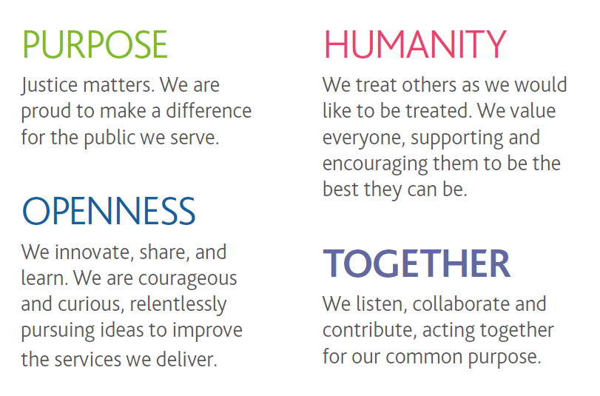

OPG values

Slide 6


OPG locations
Axis Building, 10 Holliday Street,
Birmingham, B1 1TF
Next door to the Mailbox, the nearest train stations are Birmingham New Street, Moor Street and Snow Hill, all a short walk away.
There is no onsite car parking available.
A secure bike shed is available for cyclists.
Embankment House, Waterside Business Park,
Electric Avenue, Nottingham, NG80 1EH
The nearest train station is Nottingham and you can get to Embankment House by catching the Navy 49 or 48 buses from
next to the station, Monday to Friday, every 15 minutes
(journey time of approximately 8 minutes).
Limited onsite car parking is available on a rota basis
along with a bike storage facility.

Slide 7
What’s it like to work for OPG?
Supriya Performance Manager
“My role is to help the business understand its performance and
“impact on our customers. When I joined OPG I was also training
“as a Magistrate and OPG really supported me. Flexible working
“helped me do my training alongside my job. I’ve been doing both
“roles ever since. I’ve worked at OPG for 10 years and that feeling
“of helping people is what makes me want to come to work every
“day.”
Sunyana Project Support Manager
“I joined OPG as an Administrative Officer from the private sector
“and the biggest difference was the purpose of my role.
“Previously, I’d only worked for profit organisations where the main
“objective was to maximise company revenue. At OPG our goal is
“to protect and safeguard vulnerable adults and it’s great knowing
“my work will help someone and I can play my part serving
“society.”
Nuala Deputy Head of Supervision & Investigations Services
“Every day I am surrounded by colleagues offering fantastic
“support to our customers and to each other.”
Aaron General Case Manager
“I’m proud to work at the OPG because it has given me the right
“support I need in order to progress and I have met a lot of good
“people.”
Harry Senior Investigator
“Someday we will all be our clients and someone needs to be
“there to look out for them. I’m proud to be one of those people.”
Ali Deputy Head of Power of Attorney Services
“I am proud to work at OPG because I see first-hand the positive
“difference we make to countless people who are facing
“emotionally difficult and challenging situations.”

Slide 8
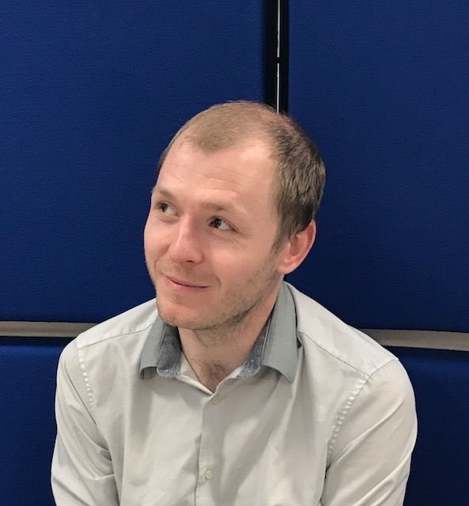
Career progression potential at OPG
Stephen talks about the opportunities he’s had to develop his career at OPG
I joined OPG as an Administrative Assistant (Band F). I got on really well with my new colleagues but wanted to get more experience and successfully applied to be an Executive Officer (Band D) line manager.
My new role was brilliant and I gained a lot of valuable experience very quickly.
I moved roles, into IT Support, getting new experiences, new skills and seeing new areas of the business.
I loved the job. I had a high-level of autonomy, and it was a problem-solving role which fitted me to the core.
I moved again, to the Continuous Improvement team. The problem-solving aspect appealed massively to me.
It was a fantastic role – really understanding how each part of the business worked and collaborated.
Lots of training was made available too and I took every opportunity.
I honed my mentoring skills which also developed me.
I worked with the Investigations team
who had a number of problems which
provided opportunities to really improve
customer service.
I successfully applied for a Senior
Investigator (Band C) position and was
tasked with trialling a new way of
managing cases and training new
Investigators.
I really worked on my soft skills, which were my weakest - but this
was a good opportunity to improve that.
The next opportunity was the role of Service Manager (Band B),
it was the role for me. I was successful, and then worked really
hard to add value to the business.
So there’s my career to date. I’m now in a place where I am thinking again about next steps, but I will follow my own advice
and look for a role that interests and challenges me.

Slide 9
9
Introduction to the role of Customer Service Advisor
The Customer Service Advisor role is contact centre based, with the
main duties of answering customer queries relating to the Mental Capacity Act 2005 and the services that OPG provide. These include powers of attorney and the supervision of court appointed deputies.
Advisors also play an important role in coaching and guiding our customers who are supporting vulnerable adults that have started to lose or have lost mental capacity. Therefore, it’s important that Advisors have the ability to show empathy and understanding towards our customers.
Customer Service Advisors receive regular management support,
and all members of the team work together to achieve our targets.
The work mainly involves communicating with our customers verbally by telephone, but also in writing, and completing the related administrative work following each interaction with a customer.
This includes updating our case management system, communicating and collaborating with colleagues across the business, among other tasks.
Hours of Work
37 hours per week Monday to Friday (Part time staff will be considered but successful candidates will need to be available 9am -5pm, Monday to Friday for the first eight weeks during initial training)
The successful candidates will be based in Nottingham but may have the opportunity to visit our office in Birmingham.

Slide 10
9
Job description, role and responsibilities
may include any of the following, but not limited to:
Supporting and contributing to the aims, objectives and performance of the Power of Attorney Services (PoAS) department to ensure delivery targets, as set out in the Business Plan, are met.
Promote a culture of excellent service delivery and continuous improvement.
Act as a point of contact for the customer, dealing with telephone enquiries and correspondence in a professional and courteous manner.
Make and answer telephone calls, in a contact centre environment, with internal and external customers, answering external customer queries and escalating to other teams where appropriate.
Be clear, honest and transparent in your communication, making decisions that involve the relevant people at the right time.
Provide high-quality customer service in line with Departmental behaviours, responding to written correspondence via post or email, ensuring that all information for customers is accurate, timely, clear and easy to understand.
Inputting and updating data on our IT systems, collating, analysing
and formatting data and information.
Work in accordance with standard operating procedures, providing constructive feedback where improvements and efficiencies can be made, contributing to the development of smarter working across
the department with the customer experience at the heart of
everything we do.
Participate in and contribute to team meetings, developing working relationships across POAS and the wider organisation where needed.
Act as a role model for staff, demonstrating behaviours within the
MoJ Leadership statement and the organisation’s values.
Be a flexible and supportive team member with good time management skills in order to prioritise work.
Take responsibility for your own learning and development with the support and guidance of your line manager.
Develop a knowledge of HR policies which you will be expected to abide by.
Take reasonable care for the health and safety of
others and abide by relevant Health & Safety
Procedures and policy.

Slide 11
11
Skills and qualifications
The post holder is required to work in a flexible way and undertake any
other duties reasonably requested by line management which are commensurate with the grade and level of responsibility of this post. There may also be a requirement to work in different departments during the course of your employment, dependent on business needs.
Skills and Qualifications
• Experience in using MS word/excel and Outlook.
• Good written and oral communication skills.
• Ability to make informed decisions based on evidence.
• Good telephone manner (ability to converse politely and articulately
• with customers on the telephone is an essential skill of the post).
• Comprehensive training will be provided.
Essential criteria:
• Proficiency in written and oral communication as telephony work
• will be required.
Desirable criteria:
• Call centre experience, which will be assessed at the interview
• stage of the recruitment process.
• Experience dealing with customers.
• Experience of working in an operational delivery area or
• administration role.
• Experience of working in a compliance environment.
• Experience of using Microsoft computer packages,
• i.e. Word, Excel, Outlook.

Slide 12
Salary and benefits, terms and conditions
Annual Leave
Generous allowances for paid holiday starting at 25 days per year,
and rising as your service increases to 30 days after 5 years.
There is also a scheme to allow qualifying staff to buy or sell up to
3 days annual leave each year.
Additional paid time off for 8 public holidays and 1 privilege day per year.
Leave for part-time and job share posts will be calculated on a pro-
rata basis.
Requests for part-time contracts will be considered in line with business needs.
Pension
The Civil Service offers a choice of pension schemes, giving you
the flexibility to choose the pension that suits you best.
Some of MoJ’s terms and conditions of service are changing as
part of Civil Service reform. The changes will apply to staff joining
MoJ who are new to the Civil Service. Staff joining MoJ from other
civil service employers will transfer onto the new MoJ terms if they
are already on 'modernised' terms in their current post or onto 'unmodernised' MoJ terms if they are on 'unmodernised' terms at
their current post.
Details will be available if an offer is made.

Slide 13
13
Flexible arrangements to enhance 'work/life balance’
Standard 37 hour working week.
Weekday working only (no mandatory weekend shifts).
Flexible working arrangements (reduced hours and/or days) available.
Flexi time – start between 7am and 10am and finish between 3pm and 7pm, Core hours being 10am to 3pm.
OPG encourages smarter and remote working for some roles.
Generous paid paternity, adoption, maternity and sickness leave.
Up to 5 days paid Special Leave per year for voluntary service.
Job-share scheme.
Career Break or Sabbatical leave of up to 5 years.
Onsite kitchen facilities.
Bike storage facilities.
6 month probation period for all new entrants.

Slide 14
15
Flexible benefits
Reward & Recognition scheme.
Salary sacrifice arrangements for childcare vouchers.
Travel permits, bicycles and voluntary benefits such as retail vouchers and discounts on a range of goods and services.
Cycle to Work Scheme hire a bike and safety equipment, tax-free,
if you use it to get to and from work.
Salary advance for annual travelcards.
Free flu jab and annual sight tests.
Free access to an Employee Assistance Programme which provides legal advice, counselling, mediation services etc.
OPG is committed to staff development and offers an
extensive range of training and development opportunities:
2-year Apprenticeships (50 hours study per year on full salary)
leading to industry-recognised qualifications.
Up to 50 paid Learning Hours per year.
Mentoring.
Secondments.
Extensive support networks e.g. Diversity & Inclusion Forum,
Gender Equality Forum, Spirit (LGBTQ+) network,
PROUD Black and Minority Ethnic network, Project Race,
Mental Health Allies, Equality, Diversity and Inclusion Advisors,
Faith Forum, Christian network, Dharmic Faiths network, Muslim network, Carers Network, Disability network,
Wellbeing Champions.

Slide 15
Our recruitment process
This vacancy is using Success Profiles, and will assess your
Behaviours and Strengths.
The Success Profiles Framework was introduced to attract and
retain people of talent and experience from a range of sectors and
all walks of life, in line with the commitment in the Civil Service Workforce Plan. The five elements of Success Profiles will assess candidates using a variety of selection methods which could include the applications form, CV, personal statement, situational judgment tests and interview.
Behaviours – the actions and activities that we do which result
in effective performance in a job, these are very similar to the old
style competencies. These can be assessed at sift and interview.
Experience – the knowledge or mastery of an activity or subject gained through involvement in or exposure to it.
Ability – the aptitude or potential to perform to the required
standard.
Strengths – the things we do regularly, do well and that motivate
us. These can only be assessed at interview.
Technical – the demonstration of specific professional skills, knowledge or qualifications.
You are required to provide a CV (no more than 2 sides of A4)
together with a Personal Statement of Suitability (500 words maximum) in support of your application. This should provide specific examples of how you meet the Essential and Desirable criteria as outlined in the Job Description and the Behaviour – Managing a Quality Service.
You should focus clearly on outlining your suitability for the post
and what you feel you would gain in your personal development
from the role.
We actively encourage you to sell yourself as an individual and the personal strengths and experience that you could bring to this post.
Your application will be sifted and, if you are successful, you will be invited to an interview which will follow the Success Profiles process.
At interview, you should expect Behaviour-based questions relating
to Managing a Quality Service (Level 1) and Delivering at Pace (Level 1) together with 4 Strength-based questions and Experience questions relating to Customer Service.

Slide 16
Recruitment Timeline
Candidates are asked to note that these dates are only indicative at this stage and could be subject to change.
Sifting
Expected to take place w/c 23/10/2019
Start
For external candidates: Vetting can potentially take between 6-9 weeks
Vacancy closes
The vacancy will close on 22/10/2019
Interviews
Expected to take place w/c 22/11/2019

Slide 17
18
Frequently asked questions
Can I apply if I am not currently a civil servant?
Yes. This role is open to suitably qualified people in the external market and to existing civil servants and those in accredited Non
Departmental Bodies.
Is this role suitable for part-time working?
This role is available for full-time, part-time or flexible working arrangements (including job share partnerships). If you wish to discuss your needs in more detail please get in touch with the point of contact at the end of this pack.
Where will the role be based?
If successful you will be based at Nottingham. Unfortunately relocation costs will not be reimbursed.
Can I claim any expenses incurred in the recruitment process?
No. Unfortunately we will not be able to reimburse you, except in exceptional circumstances and only when agreed in advance.
Is security clearance required?
Yes. If successful you must hold, or be willing to obtain, security clearance to CTC/SC/DV level.
What nationality do I need to hold in order to apply?
To be eligible for employment to this role you must be a national
from the following countries: The United Kingdom, The Republic of Ireland, The Commonwealth, a European Economic Area (EEA) Member State, Switzerland and Turkey. Certain family members of EEA, Switzerland and Turkish nationals are also eligible to apply regardless of their nationality. For further information on whether you are eligible to apply, please visit Gov.UK.
Do you offer a Guaranteed Interview Scheme?
Disabled applicants who meet the minimum selection criteria in the
job specification are guaranteed an interview. Selection will be on merit. If you wish to claim a guaranteed interview under the Disability Commitment, you should complete the relevant section of the online application. It is not necessary to state the nature of your disability.
What reasonable adjustments can be made if I have a disability?
We are committed to making reasonable adjustments in order to support disabled job applicants and ensure that you are
not disadvantaged in the recruitment and assessment
process. If you feel that you may need a reasonable
adjustment to be made, or you would like to discuss
your requirements in more detail, please contact xxxxxxxx.

Slide 18
19
Frequently asked questions
The Civil Service is committed
to becoming the most inclusive employer in the UK
What about diversity and inclusion?
We are committed to understanding, respecting and representing as broad
a range of views and backgrounds as we have in UK society. We know that
diverse perspectives and experiences are critical to an effective, modern
Civil Service.
Our vision is to ensure the Civil Service represents modern Britain and is a
truly inclusive employer – an example to other employers. We will create an
organisation where diversity is not only respected and valued – but celebrated.
What’s in it for me?
We want to maximise the potential of everyone who chooses to work for us –
regardless of background. If you’re interested in becoming a world class
leader, developing your career with us – starting with this interesting and
challenging role – Or doing things differently and inspiring colleagues,
then the Civil Service is the place for you.
Our passion for diversity and equality means creating a work environment
for all employees that is welcoming, respectful, engaging, and enriched with
opportunities for personal and professional development.
What’s next?
You’ve taken the first step and looked through this Candidate Information Pack to understand the skills and experience needed to
perform this role. Now join us in achieving our ambitions and let us help you achieve yours.

Slide 19
20
Contact Us
We encourage candidates to thoroughly review the Candidate Information Pack which explains the role and requirements before submitting an application.
To contact Shared Services Recruitment team please email - MoJ-recruitment-vetting-enquiries@sscl.gse.gov.uk
Should you have any queries regarding the job role please email the recruitment team at OPGRecruitment@publicguardian.gov.uk
Good Luck
with your application

