Slide 1
CTSC Loughborough
CTSC Support Officer
AO – Candidate Information Pack

Slide 2


Contents
Welcome Message
Terms, Conditions and Benefits
Diversity and Inclusion
FAQs
The Role
The Civil Service Commissioners and the Civil Service Code
Success Profiles
The Recruitment Process
Contact Details
Notes:
Contents page to be bright and fresh and welcoming

Slide 3
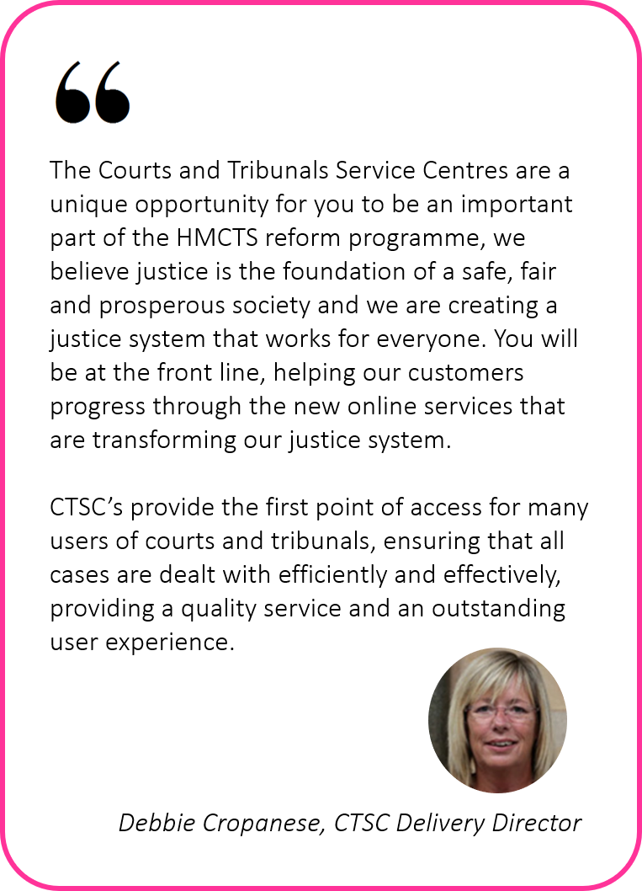
Welcome to HM Courts and Tribunal Service
Notes:
Zoe’s welcome message to be bright and fresh.

Slide 4



Diversity & Inclusion
The Civil Service is committed to becoming the most inclusive employer in the UK!
What’s in it for me?
What’s next?
Our passion for diversity and inclusion means creating a work environment for all employees that is welcoming, respectful, engaging, has a sense of belonging and enriched with opportunities for personal and professional development.
We want to maximise the potential of everyone who chooses to work for us. All colleagues are invited to join staff networks and be an integral part of any changes.
We are committed to respecting and representing a broad range of views and understanding all backgrounds we have in UK society.
We Know that diverse perspectives and experiences are critical to an effective, modern Civil Service.
Our Vision is to ensure the Civil Service represents modern Britain and is a truly inclusive employer – an example to other employers.
We will create an organisation where diversity is not only respected and valued, but celebrated.
You’ve taken the first step. We encourage you to look through this pack to understand the skills and experience needed to be a successful CTSC Support Officer.
Justice matters. Join us in achieving our ambitions and let us help you to achieve yours.

Slide 5
The Role – CTSC Support Officer
“I just wanted to drop you an email just to thank you for having me work for you…
I will forever be thankful.
When I started I had JUST finished Uni, I was lucky enough to start my ‘corporate working life’ within the Civil Service.
The experiences I have had here whilst working for Probate has allowed me to flourish and some-what become a step closer to my career goal which a lot of young adults my age cannot proudly say.
Even though I am now entering a completely different path/field, what I have learnt here will forever follow me and for that I have to thank you.
Wishing you all the success with CTSC.”
Location: Crown House, Loughborough
Pay Range: AO starting salary : £21,775 pa
What are my responsibilities?
Provide professional friendly support and guidance to users of online services via telephone, webchat and email.
Provide clear signposting and guidance to all users, coaching them in the use of the online platform and providing information to resolve their queries and processing/updating high-volume case details accurately and efficiently.
Administrative tasks within the service line using current approved processes.
Providing information to users to allow them to understand what the next stage is and what they can expect.
Identify users who require additional support.
Work as part of a team and with internal/external stakeholders.
To handle, and where possible resolve, first contact user complaints and queries.
Read relevant knowledge articles to maintain accurate and up-to-date knowledge of processes and systems, to be able to provide users with the right information, when they need it with no delay or confusion.
Training
Every single candidate has an individual training package which will fit around the role that you have applied for and will be adapted to your learning style. You will be fully supported during a 8 week learner journey which comprises of a 2 week Induction with a trainer and a 6 week Academy with dedicated Development Coaches to support you throughout your journey.
Notes:
5
Taken responsibilities from the job description and broke it down into easier chunks.
The background needs to be more engaging and inviting, to make the candidate excited for the job role. The above background is perfect but maybe moved to the bottom right hand corner to enable to wording to be seen.
5

Slide 6
CTSC Service Lines
The CTSC deliver their services through a number of Jurisdictions that we call service lines, details below:
SSCS (Social Service and Child Support)- Customers contact the CTSC in regards to decisions about their entitlement to benefits, e.g Personal Independence Payment (PIP), Employment Support Allowance (ESA) & Universal Credit. If a customer is unhappy or disagrees with a decision they can appeal to a Tribunal. Representatives from Citizens Advice Bureau and Health care professionals usually contact the CTSC on behalf of the customer.
IAC (Immigration & Asylum Chamber) - IAC is part of the Justice system of the United Kingdom under HMCTS. It hears cases relating to immigration issues and requests for asylum. It consists of two Tribunals, the First Tier and Upper Tier Tribunals looking at appeals and permission to stay in the UK.
FPLA (Family Public Law) - If parents or carers of a child are unable to show that they are providing the child with the expected level of care, the Local Authority can step in and apply to the court for an order to safeguard the child. This could be to take over primary care for the child or to more closely supervise the care given to the child by their parents.
These types of cases are heard by the Family Court and are known as Public Law cases, or sometimes Care cases.
Probate - In England and Wales, the Grant of Probate is the term used to describe the legal and financial processes involved in dealing with property, money and possessions (called the assets) of a person who has deceased. Before the next of kin or executor named in the will can claim, transfer, sell or distribute any of the deceased’s assets they will have to apply for Probate.

Slide 7
CTSC Service Lines
OCMC (Online Civil Money Claims) - OCMC Is a service the CTSC’s offer where a customer can make an online claim against an organisation or an individual for money that they believe they are owed. They may be seeking advice regarding the online process and what they need to do or chasing the progress of a case.
Divorce - When a marriage has irretrievably broken down, one of the parties can apply for a divorce. They can submit their petition online or on paper. Calls into the CTSC are in relation to progress updates of the submitted application for a Divorce to be granted.
SJS (Single Justice Service) - This service line deals with non imprisonable offences that customers may have committed such as DVLA (No Car Tax or Insurance), TV Licensing, Local Authority, Transport for London (Not paying a fare) and the Police (Speeding, No Insurance, MOT or Car Tax).
AVH & VH (Audio Video Hearings & Fully Video Hearings) – Due to the Coronavirus (COVID-19) many courts had to close. This meant that hearings had to go digital through platforms such as CVP (Cloud Video Platform) and HMCTS bespoke video conferencing. Support is required for users who are unable to access these platforms through their own technology such as Members of the public, solicitors and media.

Slide 8
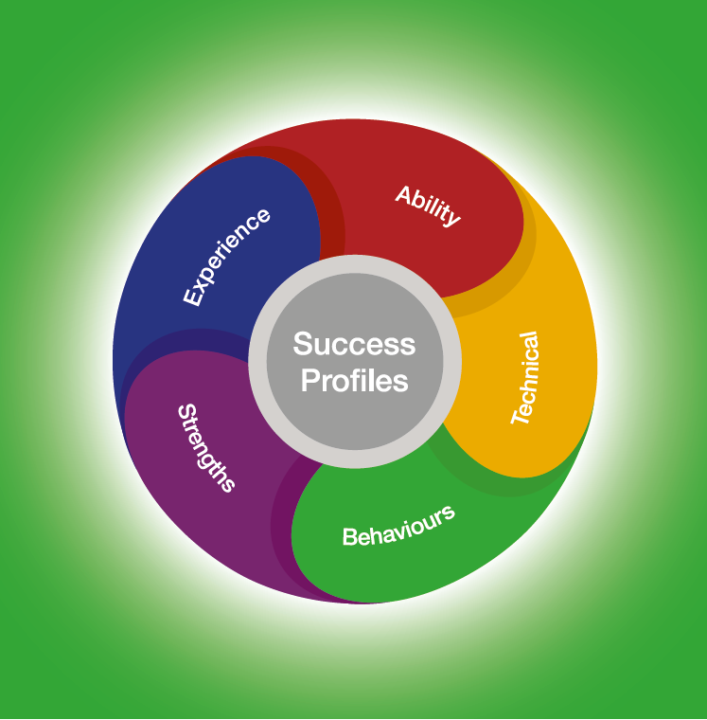
Success Profiles
What are Success Profiles?
The Success Profile Framework has been introduced into the Civil Service to attract and retain people of talent and experience from a range of sectors and diverse backgrounds and this is in line with the commitment within the Civil Service Workforce Plan
The Selection process will use the Civil Service Success Profiles Framework which assesses behaviours, strengths and their potential. Please find below the following areas we will be testing throughout the process:
Behaviours - the actions and activities that people do which result in effective performance in a job.
Strengths - the things we do regularly, do well and that motivate us.
Notes:
8
Background slides have changed
8

Slide 9




Behaviours
We will be testing the following Level 1 Behaviours on the framework for a CTSC Support Officer AO Role:
Please find further information about each of the behaviours by
viewing the Civil Service Success Profile Behaviours framework
Notes:
9
Behaviours icons to be added to page from success profiles – managing a quality service, delivering at pace, working together, communicating and influencing.
9

Slide 10
Strengths
The Civil Service is a diverse and inclusive work-place and we want to help you demonstrate your full potential throughout the assessment process
During your interview you will be asked questions to understand whether you have strengths relevant to the job role. It is important to remember that there are no right or wrong answers to these questions. Do not rehearse your answers because we are looking for your initial response. The qualities required for the role will be described in the job description. The best way to prepare is to reflect on what you feel your personal strengths are and your preferred ways of working.
Your strengths will be assessed alongside the other elements of the Success Profile to get a more rounded picture of your suitability for the role. The job description will outline the elements required for the role.
Strengths will be tested at interview and will not be provided in advance.
Please find further information about each of the behaviours by
viewing the Service Success Profile Strengths Framework
Notes:
10
Strengths icon to be added to page
10

Slide 11
The Recruitment Process
Interview
Vetting
Confirmed Offer
Start Date
Application
Sifting
Application to be completed online.
Blind sift is completed.
Interview slot booked via the portal.
If successful at interview you will go through ‘Pre Employment checks’. The vetting process can take up to 25 working days.
Following successful completion of Pre Employment checks the recruitment team will contact you to discuss and confirm a start date.
New role will commence.
A 2 week induction into the business will be mandatory followed by a 6 week learning academy.
Intake dates are subject to change. You are therefore asked to exercise flexibility through the recruitment and selection process, in order to meet the dates given.
Notes:
See comments

Slide 12
The Recruitment Process
APPLICATION
SIFTING
INTERVIEW
Successful candidates will be invited to the final stage of the recruitment process, which will be an assessment.
The assessment panel will consist of 3 panel members.
The assessment panel will ask a series of questions based on Success Profile behaviours, these are:
Managing a Quality Service
Communicating and Influencing
Delivering at Pace
Working Together
Followed by a series of strength based questions.
Successful candidates will then be offered a position– subject to pre-employment checks clearance.
Apply using the Application form on the Civil Service Jobs advert. Your application should contain your work history and qualifications, including key responsibilities and achievements. Failure to provide accurate details on your application form may result in your application being withdrawn.
Applications will be sifted on the statement of suitability.
We operate a blind recruitment policy. Personal information is not provided to colleagues completing the sift. Application answers are not provided to the panel who conduct your interview.
Find out more: Civil Service Name blind recruitment
“Every single member of staff I spoke to throughout the process were so friendly and helpful.”
CTSC Candidate, July 2021
Notes:
12
12

Slide 13

BASE LOCATION
REASONABLE ADJUSTMENTS
CONDITIONAL OFFER
You will be located at Crown House, Loughborough.
If you require any reasonable adjustments to our recruitment process, please advise the recruitment team. Examples of adjustments include providing documents in large print or braille or, allowing more time for an interview.
All offers will be conditional dependent on eligibility and pre-employment checks completing successfully.
“I would recommend the CTSC to a friend who was searching for a new role as this is an organisation that is really fun to work with and they provide individuals with an exceptional level of support.”
RESERVE LISTS
FEEDBACK
If HMCTS receives high application forms than we have vacancies for, we may hold applicants on a reserve list for 12 months for any future CTSC Support Officer vacancies, which could be offered to candidates without having to re-apply and we appoint candidates on merit order.
Due to the high volume of candidates, feedback will only be given to candidates who reach the final interview stage.
CTSC Candidate, June 2021
For more information contact: CTSC.recruitment@justice.gov.uk
Notes:
13
13

Slide 14
•
Terms, Condition's and Benefits
Location
Crown House, Loughborough.
Pension
Your pension is a valuable part of your total reward package.
We provide you with a competitive contributory pension scheme that you can enter as soon as you join, and where we will make a significant contribution to the cost of your pension. Also, your contributions will come out of your salary before any tax is taken
In extreme cases such as illness or death before retirement, your pension will continue to provide valuable benefits for you and your family. For more details, visit https://www.civilservicepensionscheme.org.uk/
Personal Development
Whatever your role, we take your career and development seriously and want to enable you to build a successful career with the Department and wider Civil Service. It is crucial that our employees have the right skills to develop their careers and meet the challenges ahead. At HMCTS you’ll benefit from regular performance and development reviews to ensure this development is ongoing. As a Civil Service employee, you’ll be entitled to a large range of benefits.
Appointment Term
Fixed Term
Working Arrangements
This role is available as full-time, part-time and flexible working – subject to business needs.

Slide 15
Terms, Condition's and Benefits
Equality Diversity and Inclusion
The Civil Service values and supports all its Employees
For example, we have strong and pro-active staff networks, special leave policies for hospital appointments, reasonable adjustments put in place for those who need them and diversity talent programmes to help everyone irrespective of background, to achieve their potential.
Generous Annual Leave and Bank Holiday Allowance
25 days annual leave on entry, increasing on a sliding scale to 30 days after 5 years’ service. This is in addition to 8 public holidays.
This will be complimented by one further day paid privilege entitlement to mark the Queen’s Birthday
With competitive maternity, paternity and parental leave we also recognise the importance of a good work-life balance and offer flexible working and a family friendly approach to work.
Staff Wellbeing
Flexible working including part-time working and access to Flexible Working Schemes allowing you to vary your working day as long as you work your total hours in line with business need.
Generous paid maternity and paternity leave
Childcare benefits (policy for new employees as of 5 April 2018): The government has introduced the Tax-Free Childcare (TFC) Scheme, so working parents can open an online childcare account and for every £8 they pay in, the government adds £2, up to a maximum of £2000 a year for each child or £4000 for a disabled child. Parents then use the funds to pay for registered childcare. Existing employees may be able to continue to claim childcare vouchers, so please check how the policy would work for you here.

Slide 16
Terms, Condition's and Benefits
Training and Development
The Department offers engaging jobs in work that really matters. These jobs have a direct impact on the quality of public services.
Our roles can offer great job satisfaction. There are many opportunities to develop and progress both within the Department and across the wider Civil Service
To create a more skilled and unified organisation, the Civil Service is developing 10 specialist areas of expertise.
Cross-government functions provide professional services and support to departments and supplement the 25 recognised professions within the Civil Service.
We are also committed to investing in our staff and we offer a range of work-based training and qualifications, coaching and mentoring opportunities and a guaranteed five days of learning a year.
Depending on contract length there maybe an opportunity to work towards achieving a personal development qualification.
Season Ticket and Bicycle Loan
Interest-free loans allowing you to spread the cost of an annual travel season ticket or a new bicycle.
Modernised Terms and Conditions
Civil Servants taking up appointment on promotion will adopt the modernised Civil Service terms and conditions which came in to effect from 1 July 2013. Existing Civil Servants appointed on level transfer will retain their existing terms and conditions.

Slide 17
FAQs
1. Can I apply if I am not currently a civil servant?
4. Is security clearance required?
7. What reasonable adjustments can be made if I have a disability?
10. Do you offer extensions to the deadline dates?
Yes. This role is open to suitably qualified people in the external market, to existing civil servants and those in accredited Non Departmental Bodies.
Yes. If successful you must hold, or be willing to obtain, security clearance to DBS level. Certain areas may also require a higher level of SC or DV clearance. More information about the vetting process can be found at the following link https://www.gov.uk/guidance/security-vetting-and-clearance
We are committed to making reasonable adjustments in order to support disabled job applicants and ensure that you are not disadvantaged in the recruitment and assessment process. Reasonable adjustments could include: allowing extra time during selection tests, ensuring that information is provided in an accessible format or, by providing training.
No. We are unable to offer extensions to the
dates provided however some of these dates
may be subject to change but it may not be
possible to offer alternative dates for assessments or interviews. You are therefore
asked to note the timetable, exercising
flexibility through the recruitment and
selection process, in order to meet the dates
given.
2. Will the role involve travel?
The role will be office based.
3. What nationality do I need to hold in order to apply?
5. Do you offer visa sponsorship?
If you feel that you may need a reasonable adjustment to be made, or you would like to discuss your requirements in more detail, please state this on your application form and feel free to contact us directly.
No. In order to be eligible for this role you must have the right to work and remain in the UK.
11. Can I apply more than once?
To be eligible for employment to this role you must be a national from the following countries:
UK nationals
Nationals of Commonwealth countries who have the right to work in the UK
Nationals of the Republic of Ireland
Nationals from the EU, EEA or Switzerland with (or eligible for) status under the European Union Settlement Scheme (EUSS)
Relevant EU, EEA, Swiss or Turkish nationals working in the Civil Service
Relevant EU, EEA, Swiss or Turkish nationals who have built up the right to work in the Civil Service
Certain family members of the relevant EU, EEA, Swiss or Turkish nationals
If you do not have existing right to work in the UK, or you are not eligible for status under the EUSS, please be aware that for this role we are not able to offer sponsorship under the Skilled Worker route.
We encourage you to check your RTW status prior to applying.
No. One application is required for your preferred Region. If you are prepared to work in more than one region, you may state you first and second preference in your application. All candidate applications will only be sifted once and only one interview will be offered. The interview will most likely be held in the region of your first preference depending on interview schedules. If multiple applications are received from any candidate, the application time-stamped the earliest will be the only application accepted. Any remaining applications will be discounted.
6. Is this role suitable for part-time working
8. I want to change something on my application form, can I resubmit my application?
The roles are advertised as Full time, Part time and flexible working subject to business need.
No. Once your application has been submitted you are unable to amend or submit another application, so do ensure that you are happy with your application before submitting.
9. Can I receive feedback on my application?
12. On Site Parking?
Due to the high volume of candidates we are only able to provide feedback to candidates
who reach the final interview stage.
On site parking available, dependant on availability. Pay and Display car parks near by.

Slide 18
The Civil Service Commissioners
and the Civil Service Code
The Commissioners have two key functions:
To maintain the principle of selection for appointment to the Civil Service on merit, on the basis of fair and open competition. For the most senior posts in the Civil Service, the Commissioners discharge their responsibilities directly by overseeing the recruitment process and chairing the final selection panel. For more information please see http://civilservicecommission.independent.gov.uk/
To promote an understanding of the Civil Service Code which sets out the constitutional framework in which all civil servants work, the values they are expected to uphold, and to hear and determine appeals made under it. For more information, please see www.civilservice.gov.uk
HMCTS adheres fully to the Civil Service Code and to the requirements and best practice suggested by the Civil Service Commissioners.
Notes:
18
18

Slide 19
Further Information
Appointment to the Civil Service is governed by the Civil Service Commission’s Recruitment Principles. If you feel a department has breached the requirement of the Recruitment Principles and would like to raise this, please contact SSCL (Moj-recruitment-vetting-enquiries@gov.sscl.com) in the first instance. If the role has been advertised externally (outside of the Civil Service) and you are not satisfied with the response, you may bring your complaint to the Commission. For further information on bringing a complaint to the Civil Service Commission please visit their web pages: http://civilservicecommission.independent.gov.uk/civil-service-recruitment/complaints/

