Slide 1
MoJ Project Delivery Function
People and Engagement Manger
Location: National/London
Grade: Band B (SEO)
Salary: £37,683 (National), £43,647 (London)

Slide 2








Move your mouse pointer over the buttons below each image and click for more information
Welcome
About Us
Vacancy Description
Recruitment Process
Indicative Timeline
Terms & Conditions
People and Engagement Manger
Candidate Information Pack

Slide 3

Welcome
About Us
Vacancy
Process
Timeline
T’s & C’s
Project Delivery in the Ministry of Justice
The Ministry of Justice (MoJ) is a major government department, at the heart of the justice system. We work to protect and advance the principles of justice. Our vision is to deliver a world-class justice system that works for everyone in society.
The organisation works together and with other government departments and agencies to bring the principles of justice to life for everyone in society. From our civil courts, tribunals and family law hearings, to criminal justice, prison and probation services. We work to ensure that sentences are served and offenders are encouraged to turn their lives around and become law-abiding citizens. We believe the principles of justice are pivotal and we are steadfast in our shared commitment to uphold them.
The MoJ Priorities
A prison and probation service that reforms offenders
A modern courts and justice system
A Global Britain that promotes the rule of law
A transformed department that is simpler, smarter and more
unified
All of the projects available in the MoJ contribute to achieving these
priorities and project professionals in the MoJ help to improve the
government’s ability to protect the public and reduce reoffending,
and to provide a more effective, transparent and responsive criminal
justice system for victims and the public.
Project Professionals in the MoJ are central to the delivery of the
Secretary of State’s priorities.
People and Engagement Manger
Candidate Information Pack

Slide 4
Welcome
About Us
Vacancy
Process
Timeline
T’s & C’s
Project Delivery in the Ministry of Justice
Your Career
To deliver MoJ’s Major Change Portfolio, we operate a flexible Project Delivery Function of project delivery professionals. Successful applicants will be posted to the Centre of Excellence team and working as part of this team provides a unique opportunity to help influence the wider development of the Project Delivery Profession for the MoJ and provides opportunities to get involved in initiatives to support that.
The team’s role is to support the embedding of professional standards, design and manage learning solutions to improve capability and engagement with leadership communities and across government to improve the delivery of our major project portfolio.
We offer a rewarding career, supporting continuous professional development and shaping a community that enables us to grow and develop within the cross-government Project Delivery Profession.
You will be supported with the right learning and development
opportunities at all points in your career through the Government Online Skills Tool (GOST) including our world-class leadership programmes, as well as supporting our Project Professionals through accredited professional learning and qualifications, providing a grounding in Project Delivery practices in Government.
You will have access to Civil Service programmes such as our Future Leaders and Senior Leaders schemes that aim to create a strong, diverse and robust pipeline through to the most senior roles in government.
You will be recognised and valued for your contribution.
People and Engagement Manger
Candidate Information Pack

Slide 5

Welcome
About Us
Vacancy
Process
Timeline
T’s & C’s
Project Delivery in the Ministry of Justice
Government Project Delivery
People and Engagement Manger
Candidate Information Pack

Slide 6
Welcome
About Us
Vacancy
Process
Timeline
T’s & C’s
Working in the Ministry of Justice
Our Values
Our vision is to deliver a world-class justice system that works for everyone in our society and our values are how we bring principles of justice to life.
We defined our values together – they can unite us as we fulfil our shared purpose.
They will guide our actions as individuals and inspire us to be the best we can be, as we deliver excellent public services.
PURPOSE
Justice matters. We are proud to make a difference for the public we serve.
HUMANITY
We treat others as we would like to be treated. We value everyone, supporting and encouraging them to be the best they can be.
OPENNESS
We innovate, share, and learn. We are courageous and curious, relentlessly pursuing ideas to improve the services we deliver.
TOGETHER
We listen, collaborate and contribute, acting together for our common purpose.
People and Engagement Manger
Candidate Information Pack

Slide 7

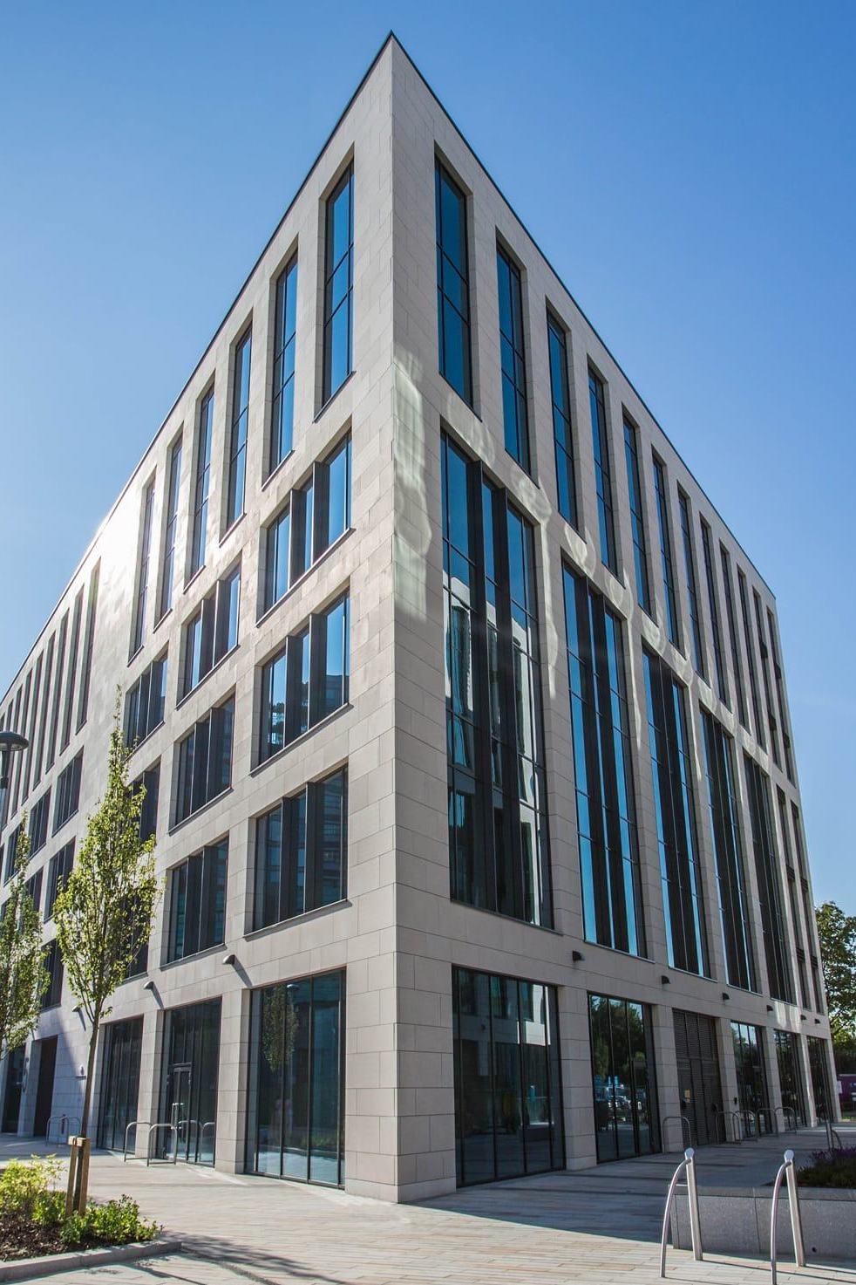

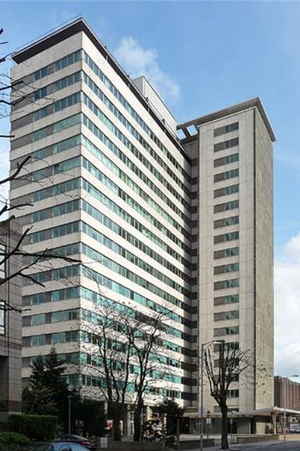
Welcome
About Us
Vacancy
Process
Timeline
T’s & C’s
Working in the Ministry of Justice
Our MoJ HQ Locations*
102 Petty France, London, SW1H 9AJ
5 Wellington Place, Leeds, LS1 4AP
Map
Map
10 South Colonnade, Canary Wharf, E14 4PU
Southern House, Croydon, CR0 1XN
Map
Map
*Please note, your base office location at an MoJ HQ site, Justice Collaboration Centre or Justice Satellite Office will be discussed if successful.
People and Engagement Manger
Candidate Information Pack

Slide 8
Welcome
About Us
Vacancy
Process
Timeline
T’s & C’s
Vacancy Description
Introduction
Job Title
People and Engagement Manger
Grade
Band B (SEO)
Salary
The salary offered will be £37,683 (National), £43,647 (London).
Pay awards are made in line with current Civil Service pay arrangements.
New entrants to the Civil Service will be expected to join on the minimum of the pay range.
Existing Civil Servants applying on promotion will usually be appointed to the salary minimum or within 10% of existing salary. Individuals appointed on level transfer will retain their existing salary.
Vacancies for this role are on a Permanent basis. Working pattern is 37 hours.
This post will require frequent weekly travel to other sites within the United Kingdom.
<<
>>
People and Engagement Manger
Candidate Information Pack

Slide 9
Welcome
About Us
Vacancy
Process
Timeline
T’s & C’s
Vacancy Description
Introduction
The Ministry of Justice (MoJ) priorities include improving public safety and reducing reoffending by reforming prisons, probation and youth justice, and building a justice system which makes access to justice swifter and more certain for all citizens whatever their background. Project professionals in the MoJ help to improve the government’s ability to protect the public and reduce reoffending, and to provide a more effective, transparent and responsive criminal justice system for victims and the public. The MoJ has the third largest investment portfolio across central government with a range of complex and innovative projects and programmes.
This role provides you with a unique opportunity to be central to the delivery of the Secretary of State’s priorities by being a member of the Ministry of Justice Project Delivery Function. The MoJ Project Delivery Function oversees the centralisation and coordination of all project delivery within the Ministry. By joining the MoJ Project Delivery Function, you will be able to access professional development opportunities including an enhanced and tailored development plan, access world leading guidance, tools and support across and access to the unique Government Project Delivery Professional Network, not to mention your participation in some of the Countries most ambitious projects. Working as part of the Centre of Excellence provides a unique opportunity to help influence the wider development of the Project Delivery Profession for the MoJ and provides opportunities to get involved in initiatives to support that. The team’s role is to support the embedding of professional standards, design and manage learning solutions to improve capability and engagement with leadership communities and across government to improve the delivery of our major project portfolio.
As the People and Engagement Manager you will support the People and Engagement Lead to provide a consistent and coherent voice for Project Delivery across the MoJ and wider Government. You will lead on facilitating the Project Delivery Accreditation for project delivery colleagues within the Project Delivery Function and across the wider MoJ. You will oversee the production and analysis of reports to identify opportunities for development activities and have regular contact with senior leaders to recommend solutions for the continuous improvement of the project delivery learning and development agenda. The role also presents a unique opportunity to work with key stakeholders across government, including the Infrastructure and Projects Authority (IPA) to help support on developing and shaping the future of the Government’s Project Delivery Profession.
The team has a collaborative ethos, and, in your role, you will work with other team members to input your ideas, experience and perspective in to supporting the design of solutions to work packages. MoJ expects its employees to show openness, honesty and commitment, and, of course, to deliver results.
<<
>>
People and Engagement Manger
Candidate Information Pack

Slide 10
Welcome
About Us
Vacancy
Process
Timeline
T’s & C’s
Vacancy Description
Key role responsibilities
These may be further shaped and adjusted dependent on business needs and team resources / skills.
Lead on the sourcing and analysing of data to identify gaps in knowledge across the MoJ project delivery profession
Lead on the design, procurement and promotion of learning packages which support project delivery professionals in progressing their technical, leadership and soft skills
Lead on the development and implementation of a capability strategy for the Project Delivery Function, ensuring that colleagues understand their roles in progressing their own and others’ learning
Assist with the development of the scope, design, and delivery of areas of continuous improvement activity, including implementing new and improved approaches to project and programme management and new and improved processes
Provide advice, support, and guidance to improve and embed continuous improvement capability, and oversee the evaluation and delivery of formal and informal learning and events
Engage with the Infrastructure and Projects Authority (IPA) to ensure MoJ have access to the latest PD capability and PD community opportunities, including supporting the PD Profession Academy rollout
Assist with sharing knowledge around use of the Government Online Skills Tool (GOST), including overseeing the allocation of licences, capability gap mapping and PD resource data
<<
>>
People and Engagement Manger
Candidate Information Pack

Slide 11
Welcome
About Us
Vacancy
Process
Timeline
T’s & C’s
Vacancy Description
Key role responsibilities
These may be further shaped and adjusted dependent on business needs and team resources / skills.
Work in a multi-disciplinary environment, where in addition to a focus upon Capability, where required the role will support other sections of the Centre of Excellence including but not limited to Service Improvement, Project Management Standards and supporting Successful Project Delivery including aspects of initiation, discovery, design, development and delivery
As required, deputise for your Line Manager and provide cover for your direct report(s). Undertake any other duties as agreed with your Line Manager
Cross government working – identify and work with stakeholders from across government to share information and knowledge and to progress key products.
<<
>>
People and Engagement Manger
Candidate Information Pack

Slide 12
Welcome
About Us
Vacancy
Process
Timeline
T’s & C’s
Vacancy Description
Essential Skills
Confident and effective personal communication skills, both oral and written, with the ability to communicate clearly with a wide variety of stakeholders
Ability to work independently and manage a busy workload to meet deadlines and deliver against priorities
Experience in working in a Project or Programme Delivery environment or role.
<<
People and Engagement Manger
Candidate Information Pack

Slide 13
Welcome
About Us
Vacancy
Process
Timeline
T’s & C’s
Recruitment Process
How to Apply
To apply for this post please apply through the Civil Service Jobs website or directly through MoJ external Jobs.
Once you have completed some basic personal details you will be invited to provide evidence of how you meet the behavioural competencies.
  The STAR Approach may also help you to present your evidence more successfully, providing structure and focus to your answers to questions about what you have done in the period the review covers.
  NB: we will sift against the first competency question if we receive a high number of applications. In your responses you should briefly introduce the context, but focus the majority of your word allocation to describe the actions you took, with a short conclusion describing the result. If your application progresses to a full sift, all competencies will then be considered.
  Please attach a copy of your anonymised CV, setting out your career history (including job title, employer and dates), and how your responsibilities and achievements meet the requirements of this role. We would expect this to be no more than two sides of A4. To note CV’s will not be made available to Vacancy Manager until interview stage.
Recruitment Principles
Overview of the Process
Arrangements for Interview
Reserve List
Closing Data
Alternative Formats
Further Information
People and Engagement Manger
Candidate Information Pack

Slide 14
Welcome
About Us
Vacancy
Process
Timeline
T’s & C’s
Recruitment Process
How to Apply
Selection for appointment to the Civil Service is on merit, on the basis of fair and open competition, as outlined in the Civil Service Commission’s Recruitment Principles.
Recruitment Principles
Overview of the Process
Arrangements for Interview
Reserve List
Closing Date
Alternative Formats
Further Information
People and Engagement Manger
Candidate Information Pack

Slide 15
Welcome
About Us
Vacancy
Process
Timeline
T’s & C’s
Recruitment Process
How to Apply
Recruitment Principles
The Project Delivery Function Management Team will manage the recruitment process in conjunction with our Shared Service Centre (SSCL) and can be contacted through SSCL.
Applications will be sifted to select those demonstrating the best fit with the post. The short list candidates will be invited to an interview. The blended interview will help us to assess candidates’ skills and strengths as described in the person specification. It will assess both what candidates are good at but also how they do it.
The panel interview will be held virtually via MS Teams. You will be advised of these details and of the format in advance of the interview.
Feedback will only be made available to candidates who make it through to the interview stage.
Overview of the Process
Arrangements for Interview
Reserve List
Closing Date
Alternative Formats
Further Information
People and Engagement Manger
Candidate Information Pack

Slide 16
Welcome
About Us
Vacancy
Process
Timeline
T’s & C’s
Recruitment Process
How to Apply
Please note expenses incurred by candidates during the recruitment process will not be reimbursed by the Ministry of Justice, except in exceptional circumstances and only when agreed in advance.
Recruitment Principles
Overview of the Process
Arrangements for Interview
Reserve List
Closing Date
Alternative Formats
Further Information
People and Engagement Manger
Candidate Information Pack

Slide 17
Welcome
About Us
Vacancy
Process
Timeline
T’s & C’s
Recruitment Process
How to Apply
If we receive applications from more suitable candidates than we have vacancies at this time, we may hold suitable applicants on a reserve list for 12 months, and future vacancies requiring the same skills and experience could be offered to candidates on the reserve list without a new competition.
Recruitment Principles
Overview of the Process
Arrangements for Interview
Reserve List
Closing Date
Alternative Formats
Further Information
People and Engagement Manger
Candidate Information Pack

Slide 18
Welcome
About Us
Vacancy
Process
Timeline
T’s & C’s
Recruitment Process
How to Apply
You must submit your application and CV by 4TH April 2023.
Applications received after this date for this campaign will not be considered.
Recruitment Principles
Overview of the Process
Arrangements for Interview
Reserve List
Closing Date
Alternative Formats
Further Information
People and Engagement Manger
Candidate Information Pack

Slide 19
Welcome
About Us
Vacancy
Process
Timeline
T’s & C’s
Recruitment Process
How to Apply
If you wish to receive a hard copy of the information, or in an alternative format e.g. Audio, Braille or large font then please contact MoJ Recruitment & Vetting Enquiries at MoJ-recruitment-vetting-enquiries@sscl.gse.gov.uk
Recruitment Principles
Overview of the Process
Arrangements for Interview
Reserve List
Closing Date
Alternative Formats
Further Information
People and Engagement Manger
Candidate Information Pack

Slide 20
Welcome
About Us
Vacancy
Process
Timeline
T’s & C’s
Recruitment Process
How to Apply
If you have any questions about the role or would like to discuss the post further, contact the Project Delivery Function Management Office at projectdeliveryres@justice.gov.uk
Recruitment Principles
Overview of the Process
Arrangements for Interview
Reserve List
Closing Date
Alternative Formats
Further Information
People and Engagement Manger
Candidate Information Pack

Slide 21


Welcome
About Us
Vacancy
Process
Timeline
T’s & C’s
Indicative Timeline
All new candidates to the Function will be required to complete a two day induction process via MS Teams or at our Leeds hub.
Induction
Please note that these dates are indicative and could be subject to change.
If you are unable to meet these timeframes, please let us know following your application by emailing SSCL.
The anticipate timetable is as follows:-
Application Sifting
Offers
Applications will be sifted to select those demonstrating the best fit with the post
If successful, you will be contacted by our shared service team with links to complete onboarding forms
TBC
4th April 2023
w/c 24th April 2023
These will start automatically, once completed you will be informed, and we will contact you to arrange a start date
Advertisement Closing Date
Interviews
Successful candidates will be invited to interview
Deadline for Submitting CV & Application Form
Pre-Employment Checks
People and Engagement Manger
Candidate Information Pack

Slide 22
Welcome
About Us
Vacancy
Process
Timeline
T’s & C’s
Terms & Conditions
Modernised Terms & Conditions
Civil Servants taking up appointment on promotion will adopt the modernised Civil Service Terms and Conditions which came into effect on 1st July 2013. Existing Civil Servants appointed on level transfer may also be expected to adopt the modernised terms if moving on a voluntary basis.
Eligibility & Nationality
Security Clearance
Reserved for UK Nationals
Conflict of Interest
Equality & Diversity
Civil Service Code
People and Engagement Manger
Candidate Information Pack

Slide 23
Welcome
About Us
Vacancy
Process
Timeline
T’s & C’s
Terms & Conditions
Modernised Terms & Conditions
The post is advertised to suitably qualified people that are existing Civil Servants and those in accredited Non Departmental Public Bodies.
To be eligible for employment you must be a national from the following countries:
The United Kingdom
The Republic of Ireland
The Commonwealth*
A European Economic Area (EEA) Member State
Switzerland
Turkey
Certain family members of EEA, Switzerland and Turkish nationals are also eligible to apply regardless of their nationality.
(*Commonwealth citizens not yet in the UK, who have no right to abode in the UK and who do not have leave to enter the UK are ineligible to apply)
For further information on whether you are eligible, please visit gov.uk.
Eligibility & Nationality
Security Clearance
Reserved for UK Nationals
Conflict of Interest
Equality & Diversity
Civil Service Code
People and Engagement Manger
Candidate Information Pack

Slide 24
Welcome
About Us
Vacancy
Process
Timeline
T’s & C’s
Terms & Conditions
Modernised Terms & Conditions
Before the appointment of the successful candidate can be confirmed, the MoJ will undertake background security checks. As part of this, you will be required to confirm your identify, employment history over the past three years (or course details if you were in education), nationality and immigration status, and criminal record (unspent convictions only)
Successful candidates must typically hold or be willing to obtain security clearance at Baseline level before taking up post. Depending on the assignment or its location, security clearance required may be increased to CTC level which will be communicated with candidates at the allocation of each assignment.
Eligibility & Nationality
Security Clearance
Reserved for UK Nationals
Conflict of Interest
Equality & Diversity
Civil Service Code
People and Engagement Manger
Candidate Information Pack

Slide 25
Welcome
About Us
Vacancy
Process
Timeline
T’s & C’s
Terms & Conditions
Modernised Terms & Conditions
Certain posts, notably those concerned with security and intelligence, might be reserved for British citizens, but this will not normally prevent access to a wide range of development opportunities within the Civil Service.
Eligibility & Nationality
Security Clearance
Reserved for UK Nationals
Conflict of Interest
Equality & Diversity
Civil Service Code
People and Engagement Manger
Candidate Information Pack

Slide 26
Welcome
About Us
Vacancy
Process
Timeline
T’s & C’s
Terms & Conditions
Modernised Terms & Conditions
Candidates must note the requirement to declare any relevant business interests, shareholdings, positions of authority, retainers, consultancy arrangements or other connections with commercial, public or voluntary bodies, both for themselves and for their spouses/partners when apply for these roles.
The successful candidate will be required to give up any conflicting interests and his/her other business and financial interests may be published.
If you believe you may have a conflict of interest, please contact projectdeliveryres@justice.gov.uk before submitting your application
Eligibility & Nationality
Security Clearance
Reserved for UK Nationals
Conflict of Interest
Equality & Diversity
Civil Service Code
People and Engagement Manger
Candidate Information Pack

Slide 27
Welcome
About Us
Vacancy
Process
Timeline
T’s & C’s
Terms & Conditions
Modernised Terms & Conditions
The Ministry of Justice is committed to being an equal opportunities employer. We value and welcome diversity and aim to develop all our staff to enable them to make a full contribution to meeting the Departments objectives, and to fulfil their own potential on merit. We will not tolerate harassment or other unfair discrimination on grounds of sex, marital status, race, colour nationality, ethnic origin, disability, age, religion or sexual orientation. We promote and support the use of a range of flexible working patterns to enable staff to balance home and work responsibilities; and treat people fairly irrespective of their working arrangements.
Under the terms of the Equality Act 2010, the MoJ is legally required to consider making reasonable adjustments to ensure that disabled people are not disadvantaged in the recruitment and selection process. we are committed to meeting, wherever possible, any needs you specify in your application and will consider any reasonable adjustments under the terms of the Act to enable any applicant with a disability (as defined under the Act) to meet the requirements of the post.
Eligibility & Nationality
Security Clearance
Reserved for UK Nationals
Conflict of Interest
Equality & Diversity
Civil Service Code
>>
People and Engagement Manger
Candidate Information Pack

Slide 28
Welcome
About Us
Vacancy
Process
Timeline
T’s & C’s
Terms & Conditions
Modernised Terms & Conditions
MoJ also offer a Guaranteed Interview Scheme (GIS) for all disabled applicants. This means we are committed to interviewing all applicants with a disability who provide evidence of meeting the minimum requirements necessary for the post, as set out in this applicant pack. To be eligible, your disability must be within the definition laid down in the Equality Act 2010. A disabled person is defined by the Act as someone who has a physical or mental impairment, which has a substantial and long-term adverse effect on their ability to perform normal day-to-day activities. For the purposes of this policy, these words have the following meaning:
'substantial' means more than minor or trivial
'long-term' means that the effect of the impairment has lasted, or is likely to last, 12 months (there are special rules covering recurring or fluctuating conditions)
'normal day-to-day activities' include everyday things like eating, washing, walking and going shopping.
Should you consider yourself eligible to apply for this post under the GIS, please indicate on your application form.
Eligibility & Nationality
Security Clearance
Reserved for UK Nationals
Conflict of Interest
Equality & Diversity
Civil Service Code
<<
People and Engagement Manger
Candidate Information Pack

Slide 29
Welcome
About Us
Vacancy
Process
Timeline
T’s & C’s
Terms & Conditions
Modernised Terms & Conditions
All civil servants are subject to the provisions of the Civil Service Code that details the Civil Service values, standards of behaviour and rights and responsibilities.
For further information, visit gov.uk.
Eligibility & Nationality
Security Clearance
Reserved for UK Nationals
Conflict of Interest
Equality & Diversity
Civil Service Code
People and Engagement Manger
Candidate Information Pack

